Slide 1
Smart Home using IoT
Prepared by:
khaled iyad al birouty
Supervised by:
Dr. Samer Hussam Eddin
ENG: Shadi saab

Slide 2
General introduction to the project framework
Hazard Detection and Immediate Mitigation
Interactive Hazard Dashboard.
Secure Access Control and Intrusion Alarm
Visual Surveillance System
Remote control of household appliances and lighting systems

Slide 3
Literature review
Paper 1: IoT-Based Fire & Gas Hazard Mitigation System
The authors designed an embedded hazard mitigation device using an Arduino Uno microcontroller coupled with an external ESP8266 Wi-Fi shield, MQ-2 gas sensor, and DHT11 temperature sensor. Upon threshold violation, the system autonomously triggers an exhaust fan and a water suppression solenoid valve while transmitting telemetry to ThingSpeak via HTTP.

Slide 4
Literature review
Paper 2: Multi-Factor Smart Door Access System
This paper investigated an electronic access control mechanism centered on a single ESP32 microcontroller. The platform integrates an MFRC522 RFID reader and a 4x4 matrix keypad to enforce two-factor authentication (2FA), paired with a magnetic reed switch to detect unauthorized physical intrusion.

Slide 5
Literature review
Paper 3: Low-Latency Surveillance and Control Infrastructure via MQTT
The authors engineered a real-time smart home management system utilizing a Raspberry Pi 4 single-board computer hosting a local Mosquitto MQTT broker, Node.js server, WebSockets, and IP camera RTSP streaming for sub-second remote control.

Slide 6
Comparative table of studied papers
Evaluation Metric | Paper 1: Safety (2023) | Paper 2: Access (2023) | Paper 3: Network (2024)
Primary Scope | Gas venting & fire spray | RFID & Keypad door lock | Video stream & MQTT
Core Controller | Arduino Uno + ESP8266 | ESP32 | Raspberry Pi 4 (SBC)
Compute Model | basic Local Logic | Standalone Local Logic | Central Local Server
Transport Protocol | HTTP Polling (Slow) | HTTP Webhooks | Local MQTT & WebSockets
Surveillance | None | None | IP Camera RTSP
Hardware Cost | Low | Low | High
Offline Resilience | Operates Locally | Operates Locally | Total System Freeze

Slide 7
Project main and secondary objectives
Main Objective:
To design, implement, and empirically validate an integrated, edge-computed IoT smart home platform uniting environmental safety, multi-factor access control, video monitoring, and remote automation based on distributed ESP32 microcontrollers and cloud MQTT messaging without centralized server or database overhead.

Slide 8
Project main and secondary objectives
• secondary objectives :
1. Real-time hazard detection, instant user notification, and automated mitigation (Gas MQ-2, Temp DHT22, Fan & Pump in ≤ 250 ms).
2. Intuitive dashboard displaying the hazard's exact type and location.
3. Secure door access control with an immediate intrusion alarm (2FA RFID + 4x4 Keypad, Reed Switch, 12V Solenoid).
4. Continuous surveillance via live video streaming and captured snapshots (ESP32-CAM event-triggered capturing).
5. Remote control of household appliances and lighting systems (Bi-directional MQTT commands from cloud web UI).

Slide 9
Technical specification table
Technical Domain | Hardware / Technology
Processing Nodes | Dual ESP32 DevKit V1
Gas Sensing | MQ-2 Sensor
Thermal Sensing | DHT22 Digital Sensor
Mechanical Actuators | Relay-driven Fan & Pump
Access Control 2FA | MFRC522 RFID & 4x4 Keypad
Perimeter Detection | Magnetic Reed Switch
Visual Surveillance | ESP32-CAM (OV2640)
Network Protocol | MQTT Standard
Local Actuation Latency | Perception to Action
Fail-Safe Autonomy | Offline Edge Continuity
Power Infrastructure | 12V/5A SMPS

Slide 10
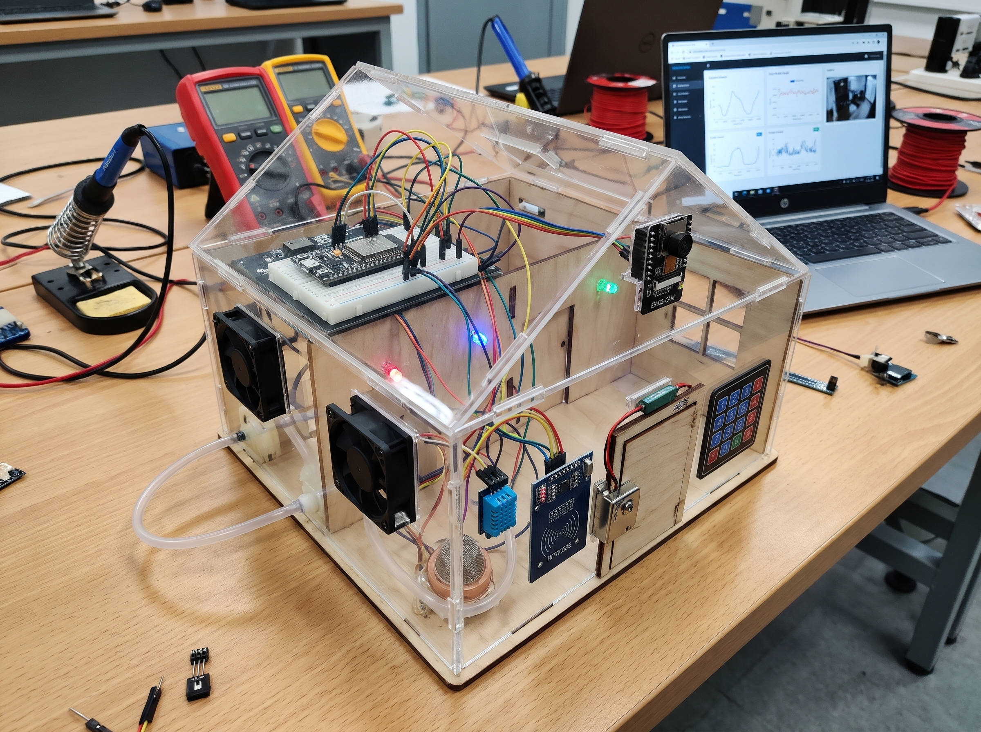
A time flowchart of the project
In the first semester: Writing the report and simulating the project using Simulink.
In the second semester: Practical hardware implementation/prototyping and conducting performance testing for the project.
In the third semester: Developing the interactive dashboard/user interface and integrating it with the entire system.

Slide 11
Thank you for your attention

